Slide 1

IT Essentials (CompTIA A+) Ch. 17
Troubleshooting Operating Systems (OS)

Slide 2
Overview
In this chapter, you will learn how to:
Troubleshoot boot problems
Troubleshoot GUI problems
Troubleshoot application problems
Notes:
2

Slide 3


Failure to Boot
Figure 17.1 If you see this screen, the problem is with hardware. Windows hasn’t even started trying to boot.
Figure 17.2 Scary error

Slide 4
Hardware or Configuration
Determine the symptoms:
Blank screen/error messages
Sounds/smells (clicking hard drive, burning components)
Hardware issue: troubleshoot and repair/replace

Slide 5
Failure to Boot: Windows XP (A CompTIA Retro Moment)
This failure occurs in the moments between the time POST ends and the Loading Windows screen appears.
For Windows XP to start loading the main operating system:
The critical system files ntldr, ntdetect.com, and boot.ini must reside in the root directory of the C: drive.
The boot.ini file must point to the Windows boot files.

Slide 6
Failure to Boot: Windows XP
Common error messages that appear during this process include:
No Boot Device Present
NTLDR Bad or Missing
Invalid BOOT.INI
If you get one of these error messages, you have two possibilities to get back up and running:
You first should attempt to repair.
If restore is either not available or fails, your only recourse is to rebuild.

Slide 7
Failure to Boot: Windows XP
Attempt to repair by using the Recovery Console.
The Recovery Console provides a command-line interface for working with Windows before the GUI starts.
Once the Recovery Console starts, follow the instructions for logging on to a Windows installation on your computer.
If there is only one installation of Windows XP on your computer, type the number 1 at the prompt and press the ENTER key).
Enter the administrator password.

Slide 8
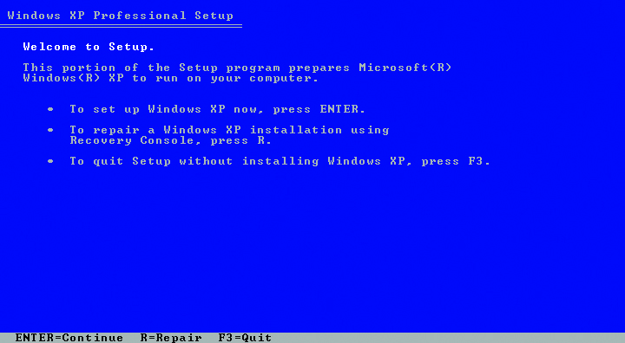
Failure to Boot: Windows XP
Figure 17.3 Initial Windows XP Setup screen

Slide 9
Failure to Boot: Windows XP
Use the Recovery Console to manually restore Registries, stop problem services, rebuild partitions (other than the system partition).
Use the expand program to extract copies of corrupted files from an optical disc or floppy disk.
The Recovery Console Works great for repairing the MBR, reinstalling the boot files, and rebuilding boot.ini.
Bad boot sector shows up as a No Boot Device Present error.
Use the fixmbr command to fix the MBR.

Slide 10
Failure to Boot: Windows XP
Missing system files are usually indicated by the error NTLDR Bad or Missing.
Copy these files from the source CD/DVD to the system within the Recovery Console.
If the boot.ini file is gone or corrupted, run this command from the Recovery Console:
bootcfg /rebuild
If the Recovery Console fixes the problem, do a thorough backup as soon as possible.

Slide 11
Failure to Boot: Windows XP
Rebuilding boot.ini
Reboot to the Windows CD-ROM and install right on top of the existing system.
Usually not the optimal solution
Swap the C: drive for a blank hard drive and install a clean version of Windows.
Then copy files and settings back over later.
Notes:
Note: Both “recovery” options do the same thing—restore your computer to the factory-installed state. If you run one of these tools, you will wipe everything off your system—all personal files, folders, and programs will go away! Before running either tool, make sure all important files and folders are backed up on an optical disc or spare hard drive.

Slide 12
Failure to Boot: Windows XP
Most OEM systems come with a misleadingly named Recovery CD or recovery partition .
The Recovery CD is a CD-ROM that you boot to and run.
The recovery partition is a hidden partition on the hard drive that you activate at boot by holding down a key combination specific to the manufacturer of that system.
Either method wipes everything off your system.
Be sure to back up important files and folders.

Slide 13
Failure to Boot: Modern Windows
Two critical boot files risk corruption in Windows Vista and Windows 7, bootmgr and bcd
You can fix both with the bcdedit tool.
You can use this tool in the Windows Recovery Environment.
Notes:
Microsoft also refers to the Windows Recovery Environment as the System Recovery Options menu.

Slide 14
Failure to Boot: Modern Windows
WinPE
With Windows Vista, Microsoft upgraded the installation environment from the 16-bit text mode environment used in every previous version of Windows to 32- and 64-bit.
Enabled the Windows installation process to go graphical and support features such as a mouse pointer and clickable elements rather than rely on command-line tools
Microsoft calls the installation environment the Windows Preinstallation Environment (WinPE or Windows PE).

Slide 15
Failure to Boot: Modern Windows
With Windows PE, you can boot directly to the Windows DVD.
Installation media is called a LiveDVD because WinPE loads directly from the disc to memory
When you access Windows PE and opt for the troubleshooting and repair features, you open a special set of tools called the Windows Recovery Environment (WinRE or Windows RE).

Slide 16
Failure to Boot: Modern Windows
Enter Windows RE
Windows Recovery Environment not only replaces the Recovery Console, it improves it.
WinRE includes an impressive, powerful set of both automated and manual utilities that collectively diagnoses and fixes all but the most serious Windows boot problems.

Slide 17
Failure to Boot: Modern Windows
Getting to Windows RE in Windows 7
First, you can boot from the Windows installation media and select Repair.
Second, you can use the Repair Your Computer option on the Advanced Boot Options (F8) menu.
Third, you can create a system repair disc before you have problems. Go to Control Panel | System and Security | Backup and Restore and select Create a system repair disc.

Slide 18
Failure to Boot: Modern Windows
Getting to Windows RE in Windows 8/8.1
Create a recovery drive on a 16 GB+ USB flash drive by accessing the Recovery applet in Control Panel.
Boot to the recovery drive.
Access WinRE from the installation media

Slide 19
Failure to Boot: Modern Windows
Reasons to access WinRE from the installation media
The hard drive can be messed up.
Accessing WinRE using the Repair Your Computer option in the Advanced Boot Options menu requires a local administrator password.
Using a bootable disc/USB flash drive enables you to avoid any malware that may be on the system.

Slide 20
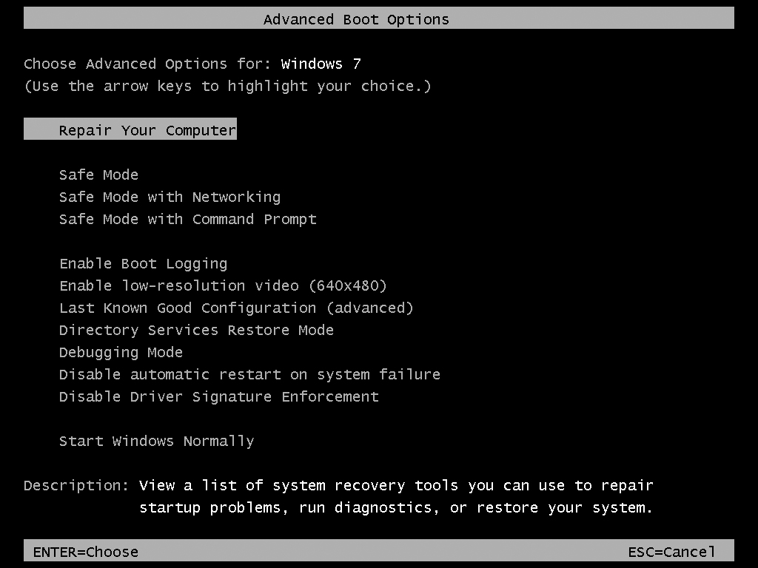
Failure to Boot: Modern Windows
Figure 17.4 Selecting Repair Your Computer in the Advanced Boot Options menu

Slide 21
Using Windows RE
Startup Repair serves as a one-stop, do-it-all option, including:
Repairs a corrupted Registry
Restores critical system and driver files
Runs the equivalent of the Recovery Console’s fixboot and fixmbr
Rolls back any non-working drivers
Uninstalls incompatible service packs and patches
Runs chkdsk
Runs a memory test to check RAM
Notes:
If you have trouble booting your computer, you should try Startup Repair first.

Slide 22
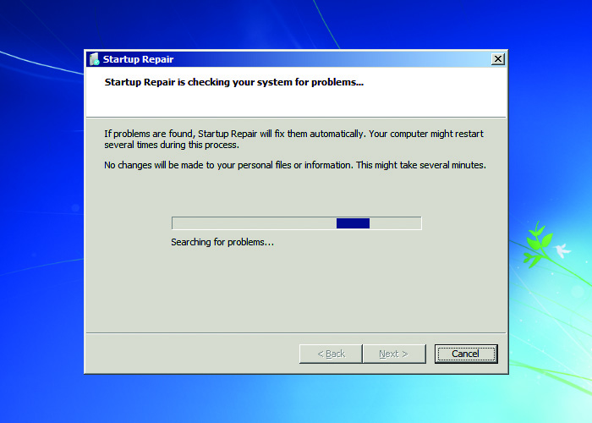
Using Windows RE
Figure 17.10 Startup Repair in action

Slide 23
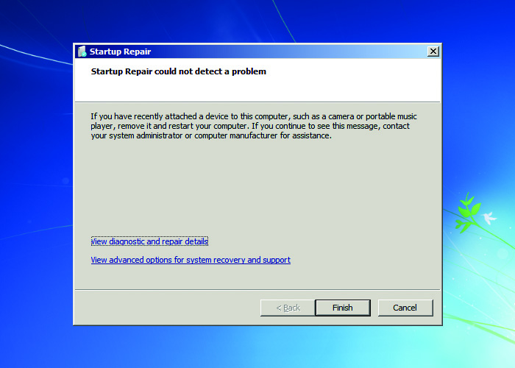
Using Windows RE
Figure 17.11 Startup Repair complete; no problems found.

Slide 24
Using Windows RE
System Restore
Uses restore points to go back to a time when your computer worked properly.
System Image Recovery/Windows Complete PC Restore uses a backup image to restore your system after a catastrophe.
It offers format and partitioning options for new disks.
It will destroy existing data on the drive when restoring backed-up data.

Slide 25
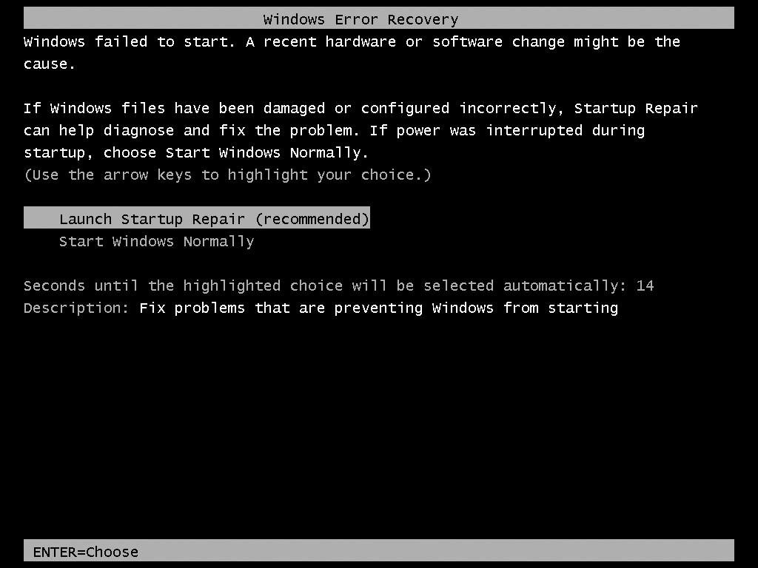
Using Windows RE
Figure 17.12 Windows Error Recovery

Slide 26
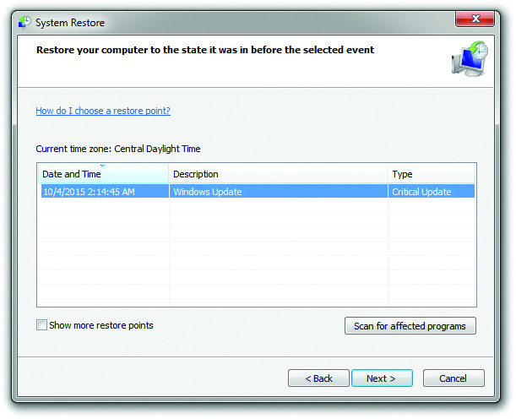
Using Windows RE
Figure 17.13 System Restore point

Slide 27
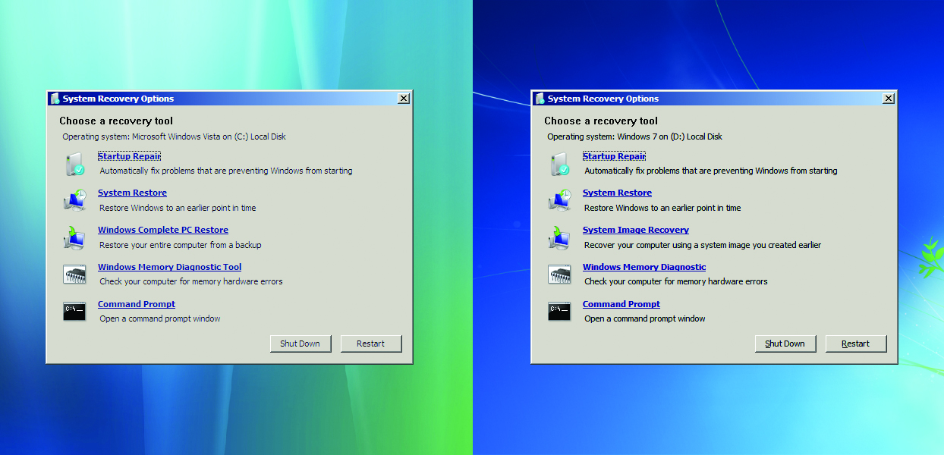
Using Windows RE
Figure 17.14 The WinRE options in Windows Vista (left) and Windows 7 (right)

Slide 28
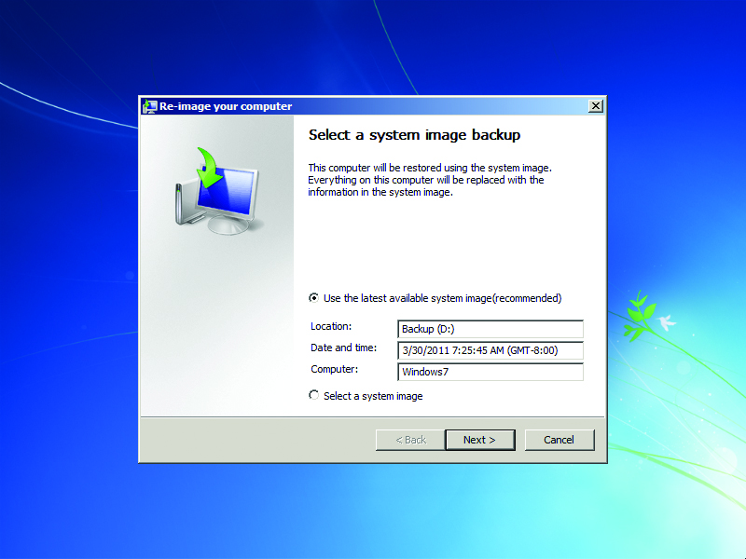
Using Windows RE
Figure 17.15 Selecting a system image

Slide 29
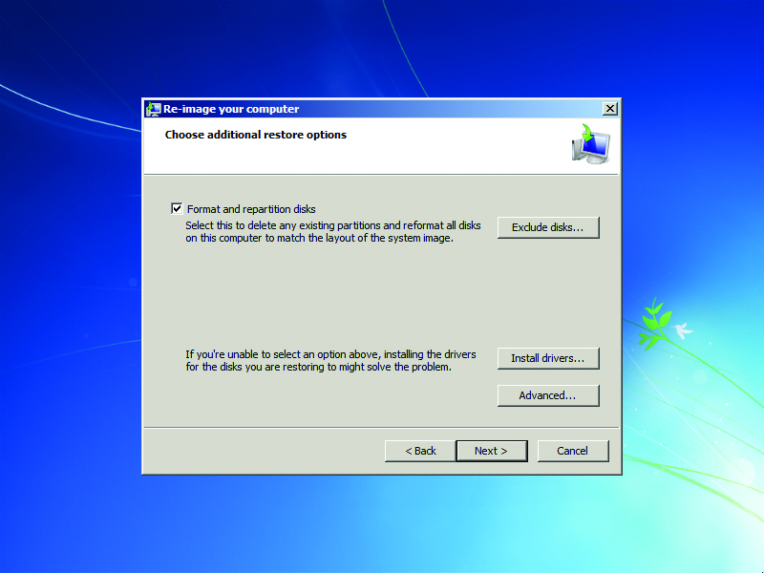
Using Windows RE
Figure 17.16 Additional restore options

Slide 30
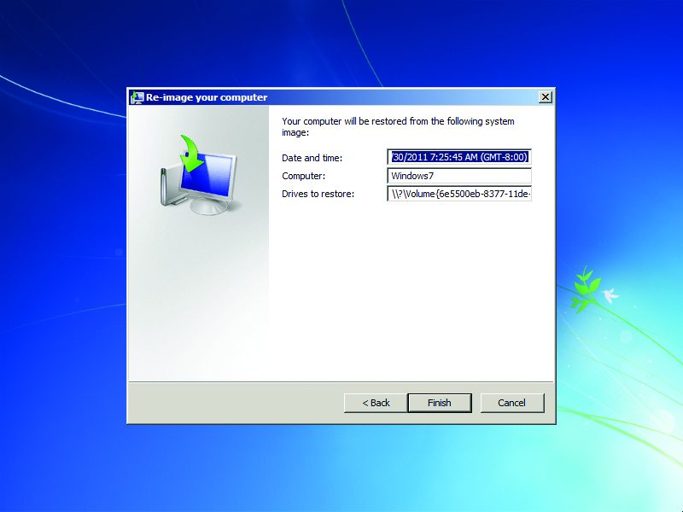
Using Windows RE
Figure 17.17 Confirming your settings

Slide 31
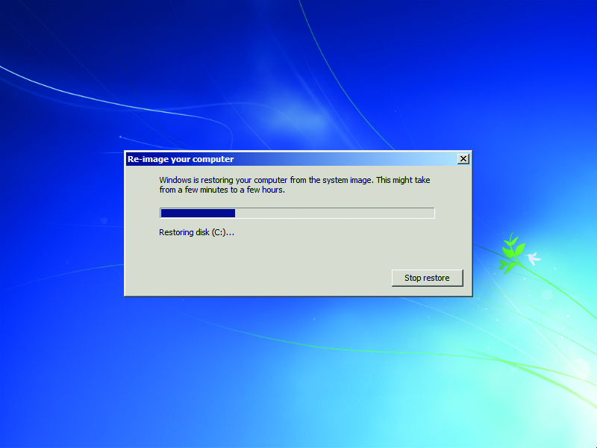
Using Windows RE
Figure 17.18 Restoring your computer

Slide 32
Using Windows RE
Windows Memory Diagnostic (Tool) tests system RAM.
When you click the Windows Memory Diagnostic (Tool) link from the main WinRE screen, it prompts you to “Restart now and check for problems (recommended)” or to “Check for problems the next time I start my computer.”
Three possible options: Basic, Standard, and Extended.
The options vary in how much time for the testing and the extent of testing.

Slide 33
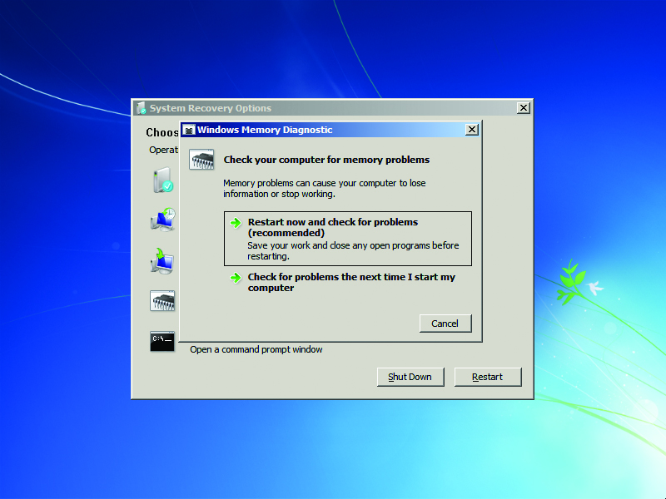
Using Windows RE
Figure 17.19 Windows Memory Diagnostic screen

Slide 34
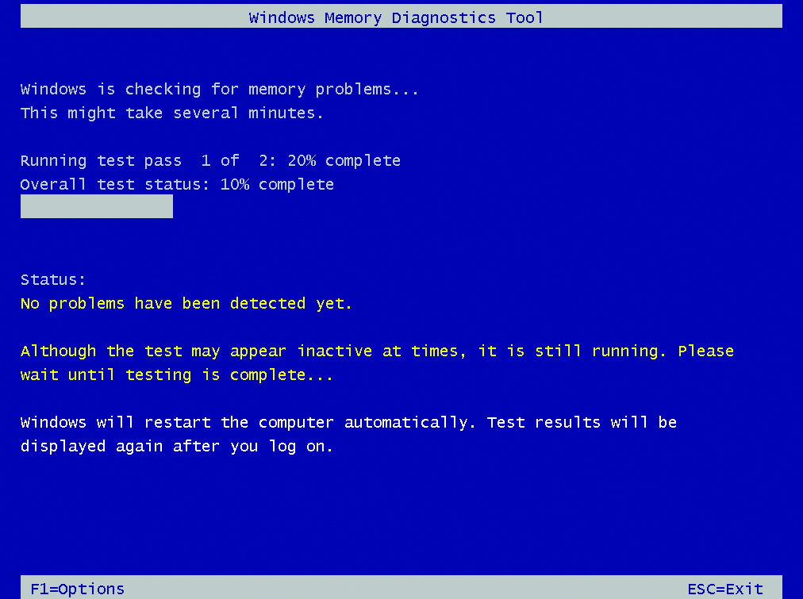
Using Windows RE
Figure 17.20 Windows Memory Diagnostic Tool running

Slide 35
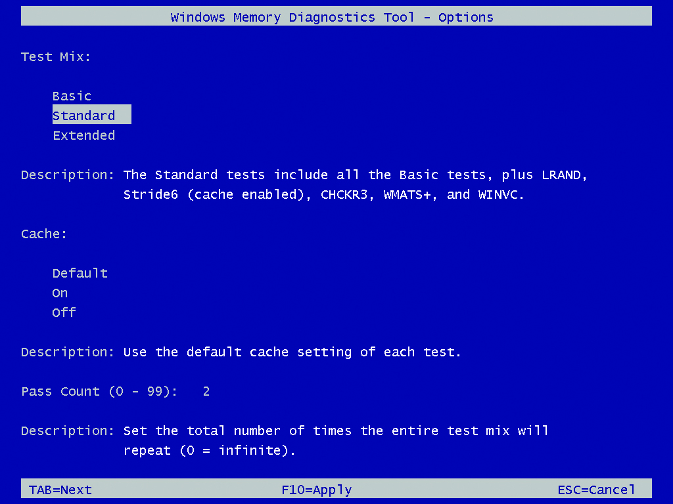
Using Windows RE
Figure 17.21 Windows Memory Diagnostic Tool options

Slide 36
Using Windows RE
Command Prompt and bootrec
The WinRE Command Prompt is a true 32- or 64-bit prompt that functions similarly to the regular cmd.exe shell in Windows.
The bootrec command repairs the master boot record, boot sector, or BCD store.
The bcdedit tool views and edits the BCD store.
Use import/export switches to make changes to the BCD store.
The diskpart tool features commands to work with volumes and partitions.

Slide 37
Using Windows RE
Refresh your PC
Available option in Windows 8 and later
Rebuilds Windows, but preserves all user file settings and purchased applications
Reset your PC
This option completely nukes your system.
Use as a last resort when troubleshooting a PC.

Slide 38
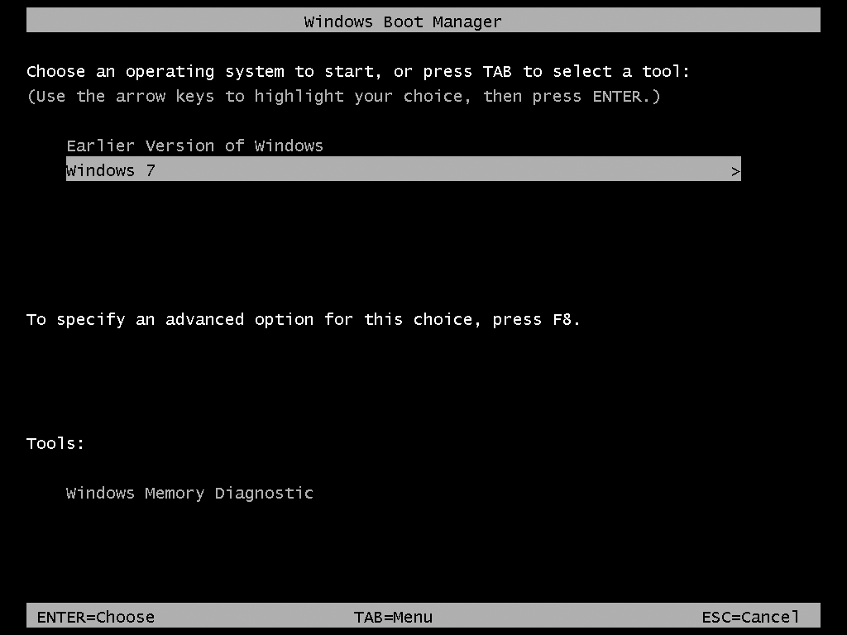
Using Windows RE
Figure 17.23 bootmgr showing available versions of Windows

Slide 39
Failure to Boot: Linux
Linux offers two common boot managers: GRUB and LILO
LILO is older and doesn’t support UEFI BIOS systems.
If GRUB is corrupted or deleted, Linux won’t start and you’ll get a “Missing GRUB” error message.
Boot to the OS Media disc and let it “install” into memory.
Access the Terminal and run the sudo grub-install command along with the location of the boot drive to repair.

Slide 40
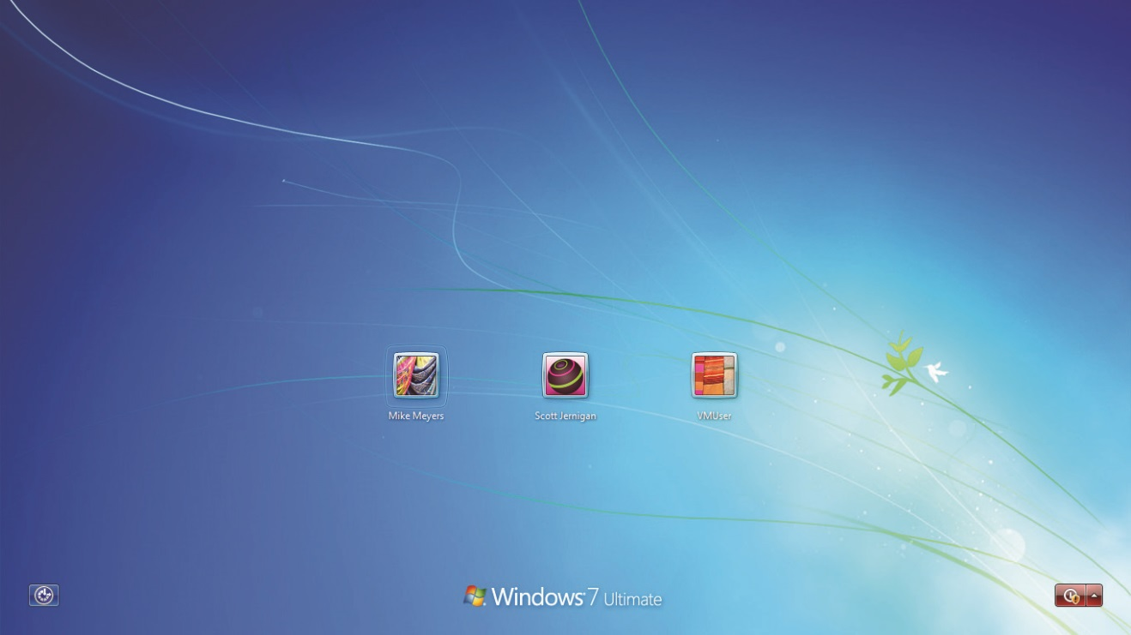
Failure to Start Normally
Figure 17.24 Login screen

Slide 41
Device Drivers
Stop error or Blue Screen of Death (BSoD)
A Windows BSoD tells you the name of the file that caused the problem and usually suggests a recommended action.
BSoD problems due to device drivers almost always occur immediately after you’ve installed a new device and rebooted.
Take out the device and reboot.
If this fixes the problem, look for updated drivers at the manufacturer’s web site.

Slide 42
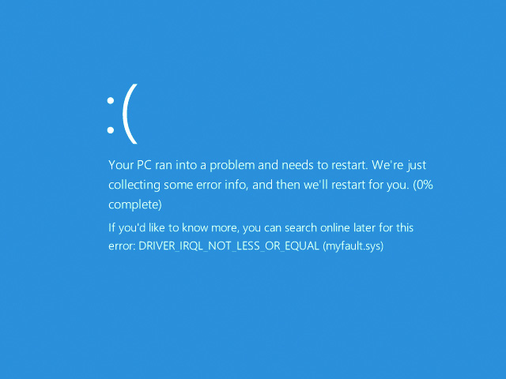
Device Drivers
Figure 17.25 BSoD in Windows 8.1

Slide 43
Device Drivers
The second indication of a device problem that shows up during startup is a freeze-up: the Windows startup screen just stays there and you never get a chance to log on.
If this happens, try one of the Advanced Startup Options.
In Linux, drivers can trip up causing a kernel panic.
Go to the manufacturer’s Web site and find updated drivers or kernel modules.

Slide 44
Registry
The Registry files load every time the computer boots.
If Windows attempts to load a bad Registry, these errors may show up as:
BSoD that says “Registry File Failure”
Text error that says “Windows could not start”

Slide 45
Registry
Replacing the Registry
Windows keeps a regular backup of the Registry handy in case you need to overwrite a corrupted Registry.
By default, the task runs every 10 days, so that’s as far back as you would lose if you replaced the current Registry with the automatically backed-up files.
You can find the backed-up Registry files in \Windows\System32\config\RegBack

Slide 46
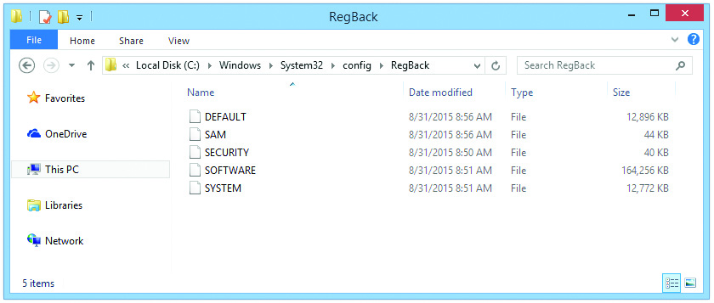
Registry
Figure 17.26 The backed-up Registry files located in the RegBack folder

Slide 47
Registry
To replace the Registry, boot to the Windows DVD to access Windows RE and get to the Command Prompt shell.
Run the reg command to get to a reg prompt.
From there, you have numerous commands to deal with the Registry.
The simplest is probably the copy command.
Copy the files to the location of the main Registry files—up one level in the tree under the \config folder.

Slide 48
Advanced Startup Options
If Windows fails to start up, use the Windows Advanced Startup Options menu to discover the cause.
To get to this menu, restart the computer and press F8 after the POST messages but before the Windows logo screen appears.

Slide 49
Advanced Startup Options
Safe Mode (all versions)
Starts up Windows but loads only very basic, non–vendor-specific drivers for the mouse, 800 x 600 (Vista/7) or 1024 x 768 (8/8.1) resolution monitor, keyboard, mass storage, and system services.
Once in Safe mode, you can use Device Manager to enable or disable devices.
There is no safety or repair feature in any version of Windows that makes the OS boot to Safe mode automatically—this has to be configured in msconfig.
Notes:
Note: In most cases, if Windows boots automatically to Safe mode, someone has set the System Configuration utility to force Windows to do so. Type msconfig at the Start | Search or Start | Run option and press ENTER to open the System Configuration utility, and then deselect the Safe boot or Boot to Safe Mode check box.

Slide 50
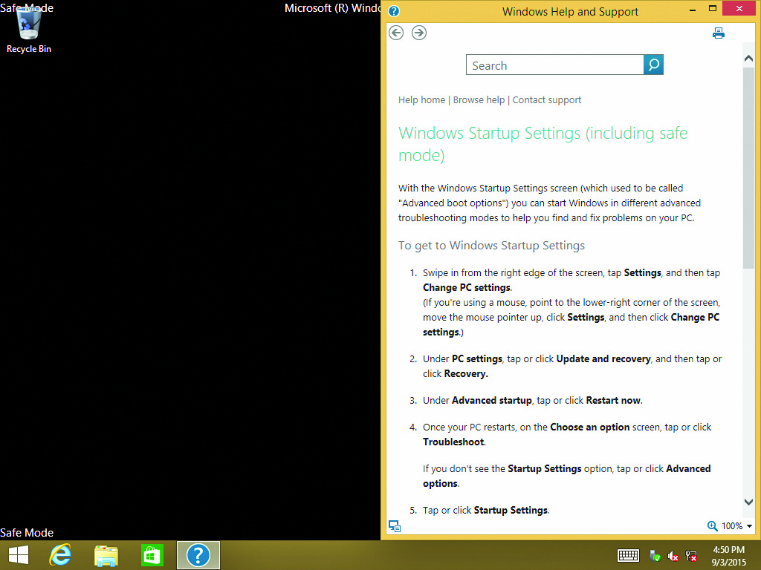
Advanced Startup Options
Figure 17.27 Safe Mode

Slide 51
Advanced Startup Options
Safe Mode with Networking
Identical to Safe mode except that you get network support
Safe Mode with Command Prompt
Loads a command prompt (cmd.exe) as the shell to the OSafter you log on
This is a handy option to remember if the desktop does not display at all.

Slide 52
Advanced Startup Options
Enable Boot Logging
Starts Windows normally and creates a log file of the drivers as they load into memory.
The file is named Ntbtlog.txt and is saved in the %SystemRoot% folder.
Enable Low-Resolution Mode
Starts Windows normally but loads only a default VGA driver.
If this mode works, it may mean you have a bad driver, or it may mean you are using the correct video driver but it is configured incorrectly.

Slide 53
Advanced Startup Options
Last Known Good Configuration
Use this when Windows’ startup fails immediately after installing a new driver but before you have logged on again.
Applies specifically to new device drivers that cause failures on reboot
Directory Services Restore Mode
Applies only to Active Directory domain controllers

Slide 54
Advanced Startup Options
Debugging Mode (all versions)
Starts Windows in kernel debug mode
Disable Automatic Restart on System Failure
Stops the computer from rebooting on Stop errors and gives you the opportunity to write down the error and find a fix

Slide 55
Advanced Startup Options
Disable Driver Signature Enforcement
If you are using an older driver to connect to your hard drive controller or some other low-level feature, you must use this option to get Windows to load the driver.
Start Windows Normally
This choice starts Windows normally, without rebooting.

Slide 56
Advanced Startup Options
Reboot
Performs a soft reboot of the computer.
Return to OS Choices Menu
Returns you to the OS Choices menu, from which you can select the OSto load.

Slide 57
Troubleshooting Tools
Event Viewer
Event View is a powerful logging tool for troubleshooting and security.
When first opened, four main bars appear in the center pane: Overview, Summary of Administrative Events, Recently Viewed Nodes, and Log Summary.
Summary of Administrative Events breaks down events into different levels:
Critical, Error, Warning, Information, Audit Success, and Audit Failure

Slide 58
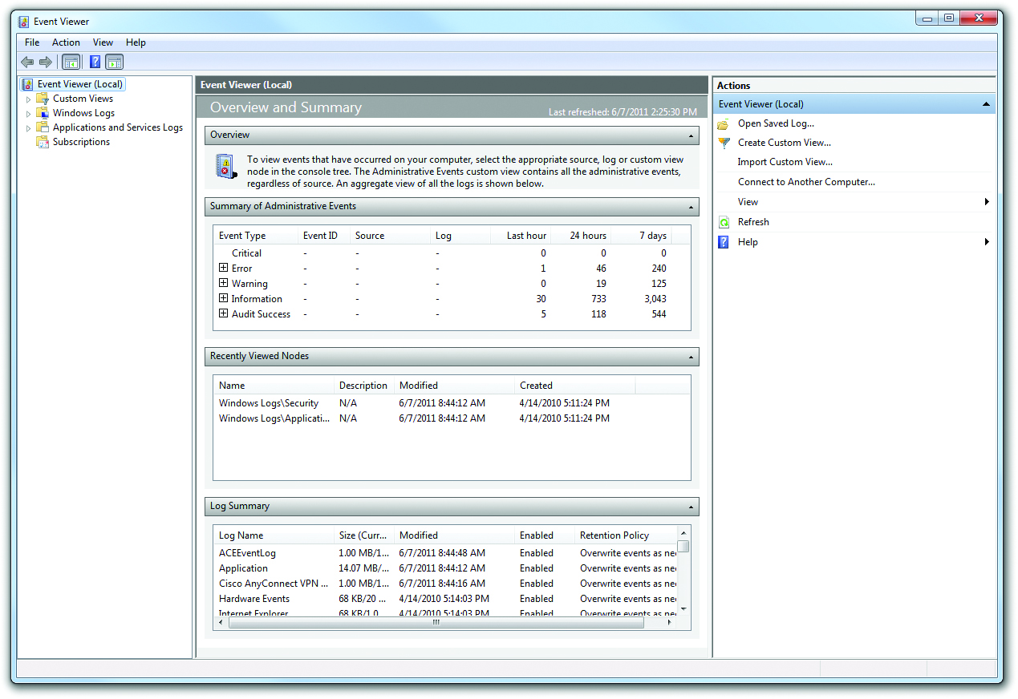
Troubleshooting Tools
Figure 17.29 Windows 7 Event Viewer default screen

Slide 59
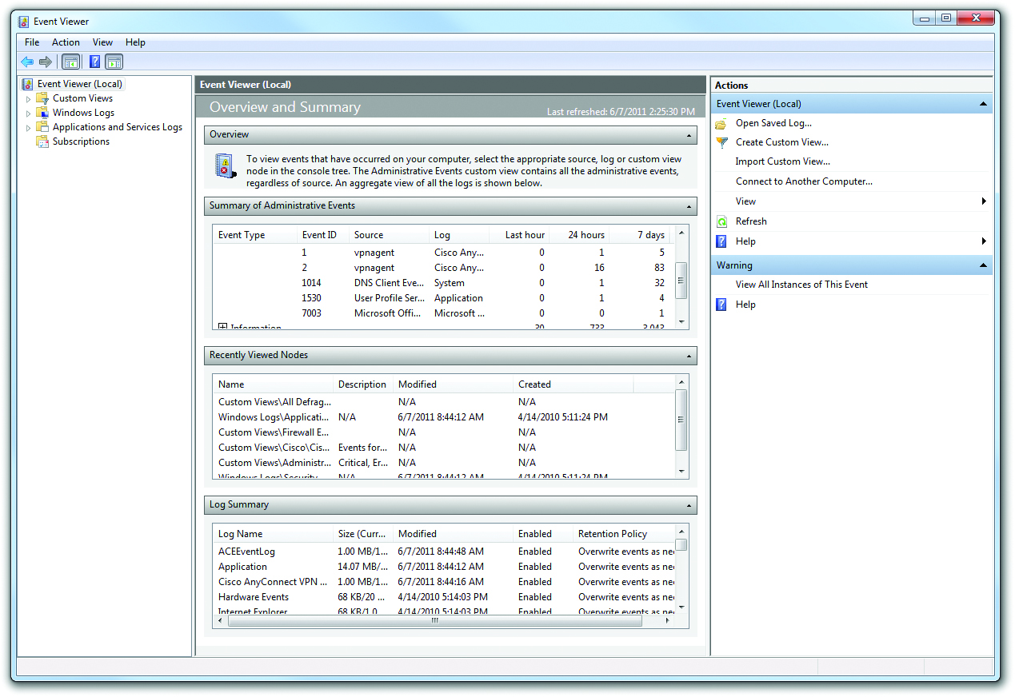
Troubleshooting Tools
Figure 17.30 Warning Events open

Slide 60
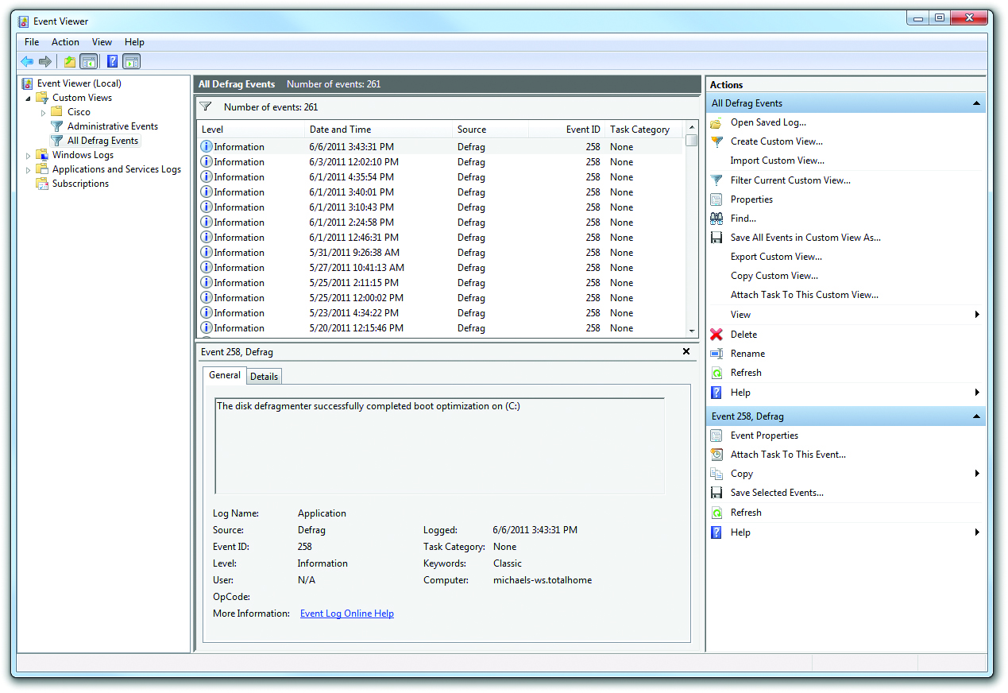
Troubleshooting Tools
Figure 17.31 Created custom Views

Slide 61
Troubleshooting Tools
Autoloading programs
When one of the autoloading programs does not start properly, you need to shut off that program.
Use the System Configuration utility to temporarily stop programs from autoloading.
If you want to make the program stop forever, go into the program, find a load on startup option, and turn it off.

Slide 62
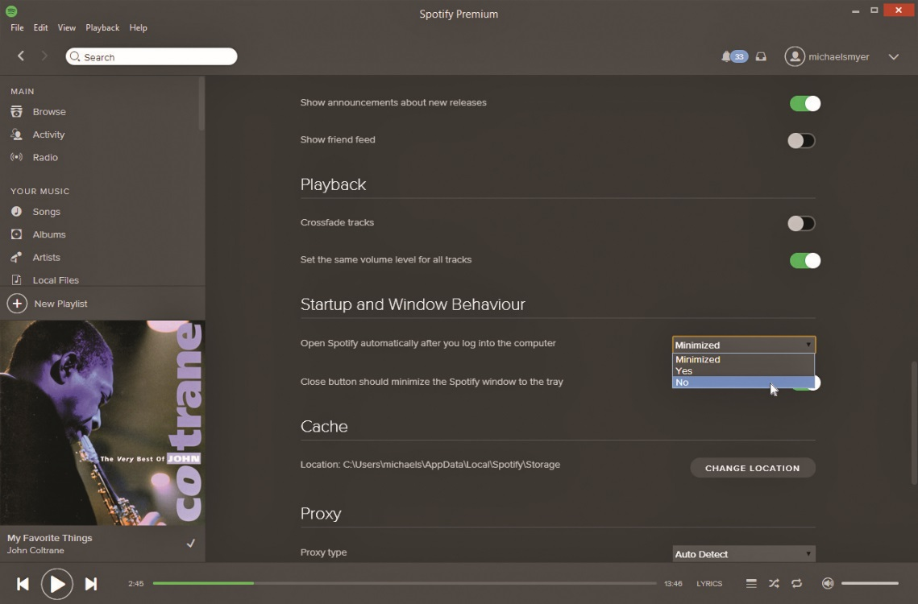
Troubleshooting Tools
Figure 17.33 Typical load on startup option

Slide 63
Troubleshooting Tools
Services
When any critical service fails to load, Windows tells you with an error message.
Go to the Control Panel | Administrative Tools | Services to verify that the service you need is running—if not, turn it on.
Each service has a startup type—Automatic, Manual, or—that defines when it starts.
It’s very common to find that a service has been set to manual when it needs to be set to automatic so that it starts when Windows boots.

Slide 64
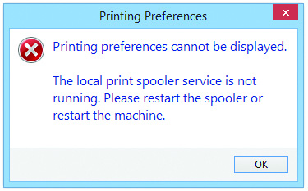
Troubleshooting Tools
Figure 17.34 Service error

Slide 65
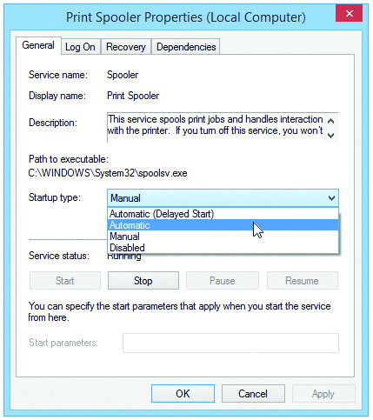
Troubleshooting Tools
Figure 17.35 Autostarting a service

Slide 66
Troubleshooting Tools
Task Manager and command-line options
Task Manager enables you :
To see all applications or programs currently running
To close an application that has stopped working
If you’re unable to get Task Manager, go to a command prompt and type the command tasklist to find the names and process IDs of all the running processes.
You can then run taskkill to end any process either by filename or by process ID.

Slide 67
Troubleshooting Tools
System files
Use the System File Checker to check and replace a number of critical files, including the important DLL cache.
System Restore
Use System Restore from the Windows Recovery Environment, or you can use restore points from within Windows.

Slide 68
More Control Panel Tools
Problem Reports and Solutions
The Problem Reports (called Problem Reports and Solutions in Vista) Control Panel applet in Windows Vista lists all Windows Error Reporting issues (as well as firewall and antimalware status).

Slide 69
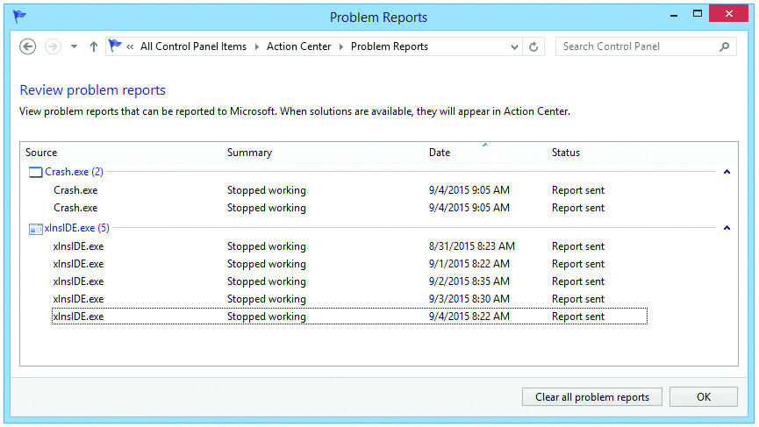
More Control Panel Tools
Figure 17.37 Problem Reports

Slide 70
More Control Panel Tools
Action Center (Windows 7/8/8.1) provides a one-page aggregation of event messages, warnings, and maintenance messages.
Separates issues into two sections, Security and Maintenance, making it easier to scan a system quickly
Only compiles the information, taking data from well-known utilities such as Event Viewer, Windows Update, Windows Firewall, and UAC and placing it into an easy-to-read format

Slide 71
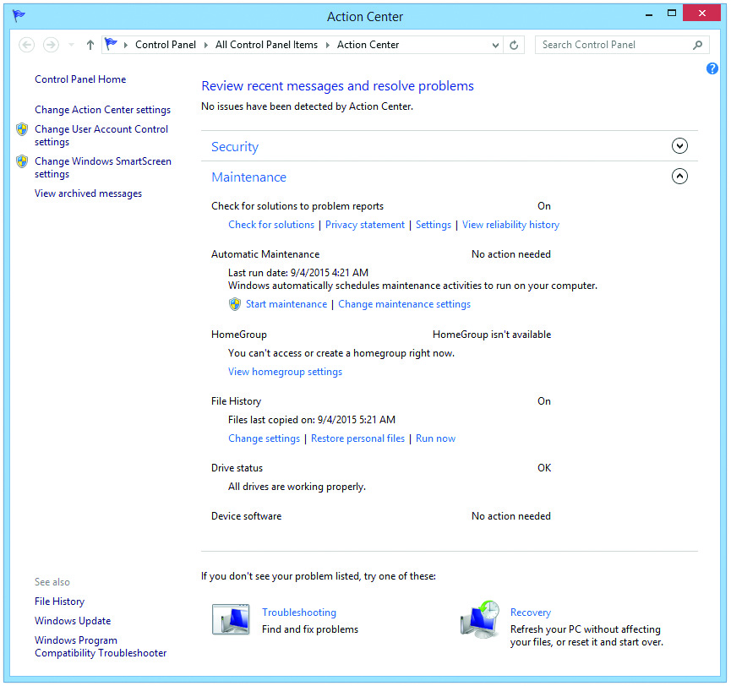
More Control Panel Tools
Figure 17.38 Action Center

Slide 72
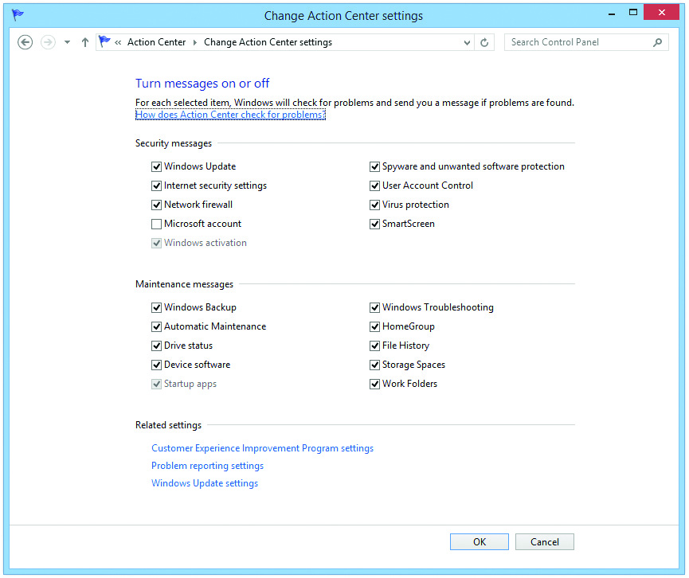
More Control Panel Tools
Figure 17.39 Change Action Center settings

Slide 73
More Control Panel Tools
Action Center applet provides direct links to some or all of the following tools:
UAC
Performance Information and Tools
Backup and Restore
Windows Update
Troubleshooting Wizard
System Restore
Recovery

Slide 74
More Control Panel Tools
Performance Information and Tools
The Performance Information and Tools applet doesn’t fix anything; it provides a comparison using the Windows Experience Index.
Windows bases performance on five components:
Processor—calculations per second
Memory (RAM)—memory operations per second
Graphics—desktop performance for Windows Aero
Gaming graphics—3-D graphics performance
Primary hard disk—disk data transfer rate
Each component generates a subscore.

Slide 75
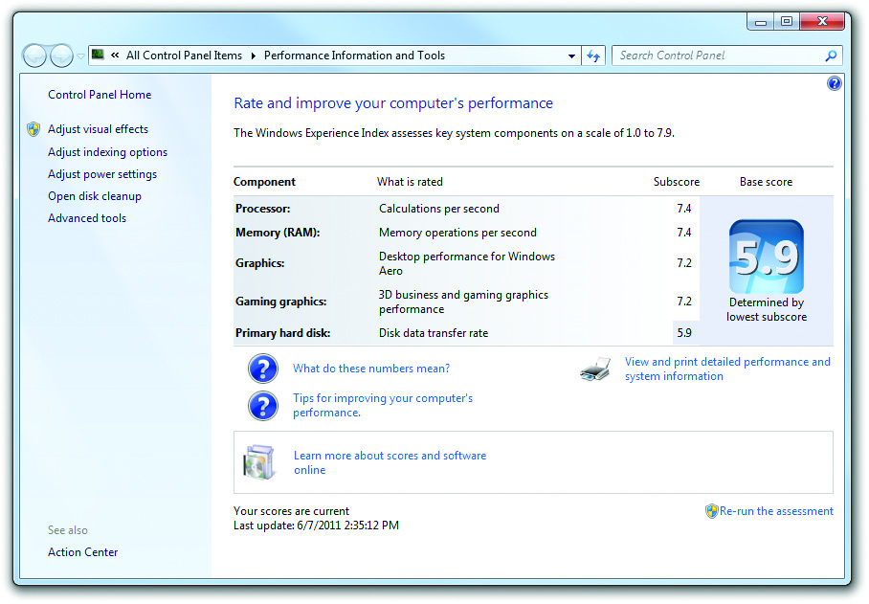
More Control Panel Tools
Figure 17.40 Performance Information and Tools

Slide 76
Application Problems
Application installation problems
Almost all Windows programs come with some form of installer.
If you insert a software disc, Windows knows to look for a text file called autorun.inf.
The autorun.inf file tells Windows which file to run off the disc, usually setup.exe.
If you download an application, you’ll need to double-click it to start the installation.

Slide 77
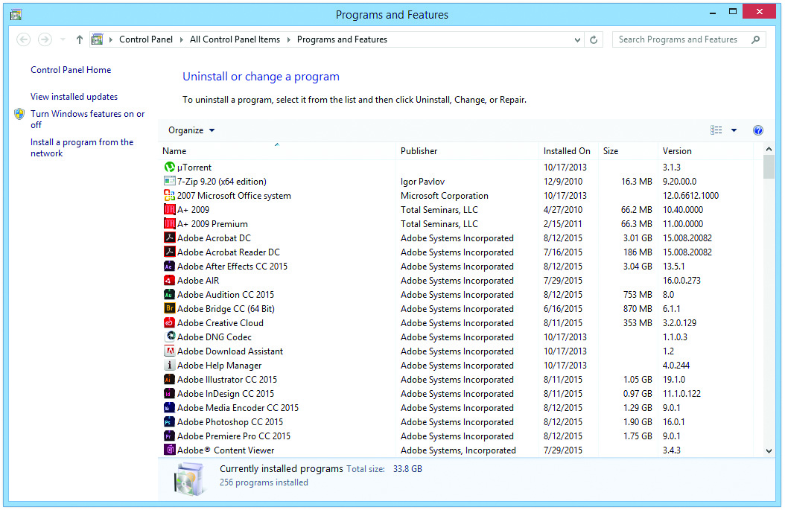
Application Installation Problems
Figure 17.41 Programs and Features Control Panel applet

Slide 78
Application Installation Problems
With most installation issues, a problem with Windows prevents programs from installing, usually the lack of some other program that the application needs so it can operate.
Microsoft .NET Framework provides an example.
.NET is an extension to the Windows OSthat includes support for a number of features, particularly powerful interface tools and flexible database access
If a program is written to take advantage of .NET, .NET must itself be installed.

Slide 79
Application Installation Problems
In most cases, if .NET is missing, the application should try to install it at the same time it is installed, but this may not happen.
If .NET is missing or if the version of .NET you are using is too old, you can get errors.
These types of errors usually require you to go online and do Web searches, using the application name and the error.

Slide 80
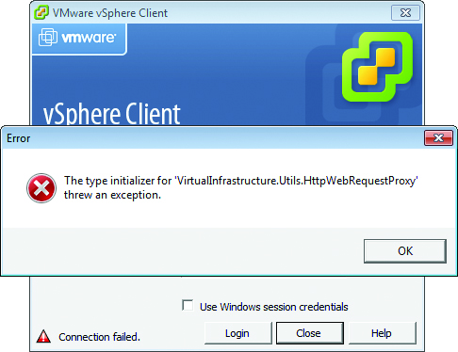
Application Installation Problems
Figure 17.42 .NET error

Slide 81
Problems with Uninstalling
The single biggest problem with uninstalling is that people try to uninstall without administrator privileges.
If you try to uninstall and get an error, log back on as an administrator and retry.
You can right-click on most installation menu options on the Programs menu and select Run as administrator to switch to administrator privileges.

Slide 82
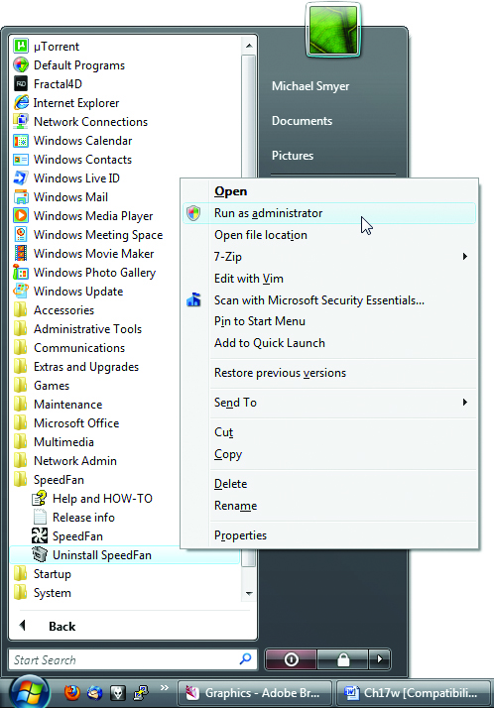
Problems with Uninstalling
Figure 17.43 Selecting Run as administrator from the context menu

Slide 83
Compatibility
Windows provides various different forms of compatibility modes to support older applications.
Examples of options accessed through the Compatibility tab under Display settings include:
Reduced color mode
Run in 640 x 480 screen resolution
Disable desktop composition (Vista/7)
Disable display scaling on high DPI settings
Run this program as administrator
Enable this program to work with OneDrive files
Change settings for all users

Slide 84
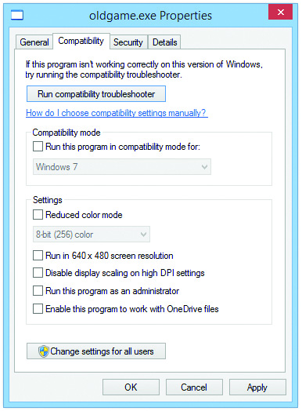
Compatibility
Figure 17.44 Windows 8.1 Compatibility tab

Slide 85
Compatibility
If you need to make things 100 percent compatible with Windows XP and you have Windows 7 (Professional, Ultimate, and Enterprise only) installed on your system, you can download Windows XP Mode.
Windows XP Mode is a premade Windows XP SP3 virtual machine that runs under Microsoft’s popular (and free) virtualization program, Windows Virtual PC.

Slide 86
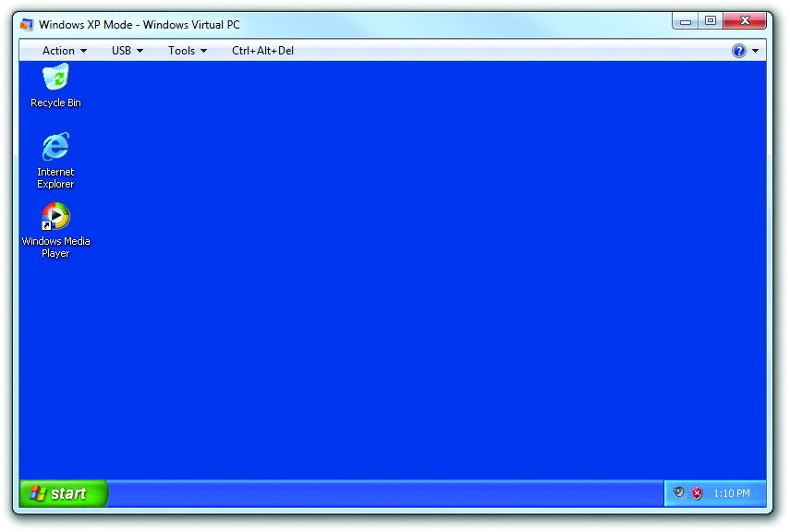
Compatibility
Figure 17.46 Windows XP Mode

Slide 87
Missing File or Incorrect File Version
An application may rely on other files, in particular DLL files.
Sometimes the application installer will bring specially formatted versions of common DLL or other files to Windows, overwriting the previous versions.
Later applications might look for the earlier version of the DLL and fail when it’s not found.

Slide 88
Missing File or Incorrect File Version
The usual fix is to perform an Internet search for the missing DLL or file that fails to open, along with the name of the program you’re trying to use.

Slide 89
Crashing Programs
Sometimes error-prone code causes the application to crash or even causes the OSto crash.
Symptoms caused by such programs are the computer locking up, unexpectedly shutting down, or a crash-to-desktop (CTD).
The system might spontaneously shut down and restart. That kind of improper shutdown can cause problems, especially to open files and folders.

Slide 90
Crashing Programs
In some cases, where the program runs but degrades the overall performance of Windows, it could point to the application side of things rather than the hardware or drivers, especially if the computer successfully runs other programs.

Slide 91
Volume Shadow Copy Service and System Protection
Volume Shadow Copy Service (VSS) enables the OS to make backups of any file, even one that is in use.
Windows uses VSS for its System Protection feature.
Enables you to access previous versions of any data file or folder

Slide 92
Volume Shadow Copy Service and System Protection
If any of the following criteria are met, you will have at least one previous version in the list:
The file or folder was backed up using the backup program.
You created a restore point.
The file or folder was changed.

Slide 93
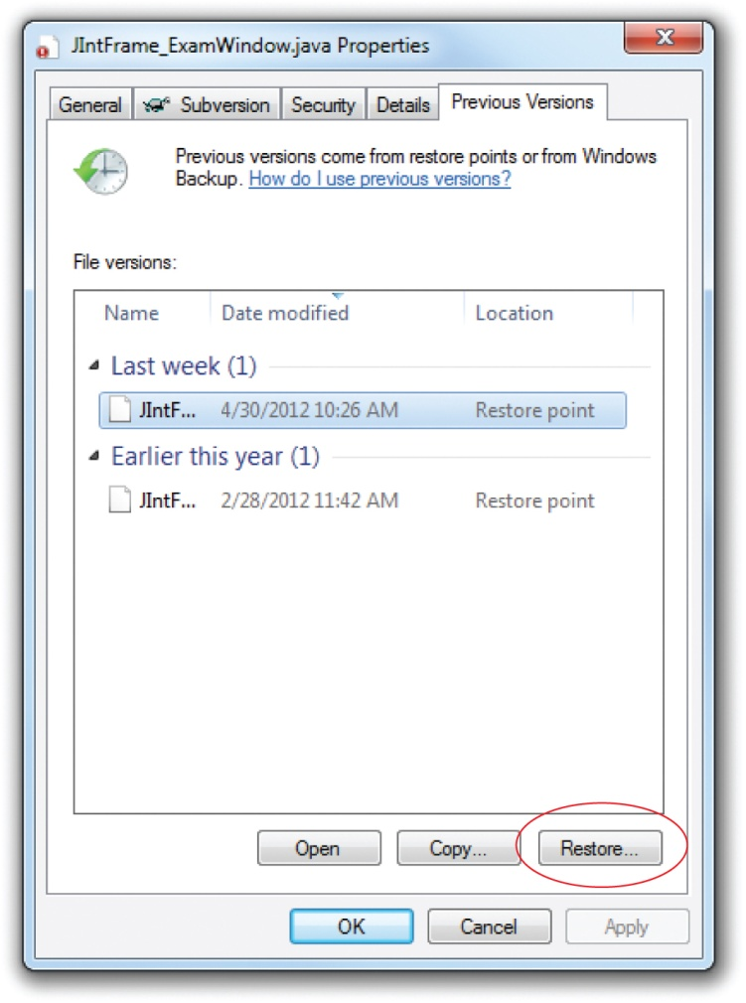
Volume Shadow Copy Service and System Protection
Figure 17.47 Previous Versions tab

Slide 94
Volume Shadow Copy Service and System Protection
Make sure System Protection is enabled.
Go to the System Protection tab in the System Properties dialog box.
The feature should be running by default.

Slide 95
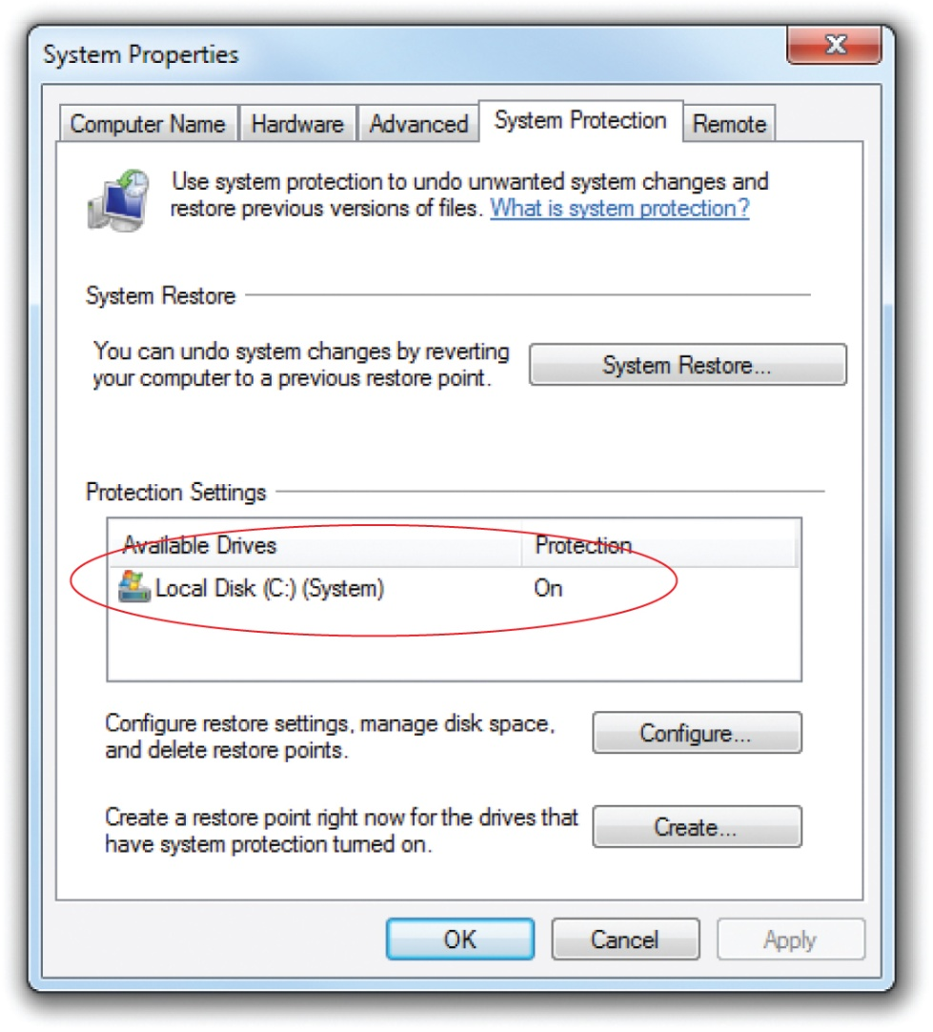
Volume Shadow Copy Service and System Protection
Figure 17.48 System Protection tab

Slide 96


Slide 97
Summary
Troubleshoot boot problems
Troubleshoot GUI problems
Troubleshoot application problems

Slide 98


